Slide 1
XSS Lab Instruction (Do Task 4, 5, *6, 7 only)
Week 9 Session 3
*Additional requirement for task 6

Slide 2
Task 4: Add Friend
Similar to what you did in CSRF attack
Step 1: Observe what does a normal client do?
Need some tools to inspect the HTTP headers (e.g., a browser plugin ‘HTTP Head Live’ or the web develop tool in the browser)
As well as the webpage (e.g., ‘inspect element’ or ’view source code’ in the browser)
Step 2: Edit user’s page to inject JS scripts
The code will be triggered whenever a victim visits the page
Step 3: Mimic the operation in Step 1 in the JS script
Construct a URL to add friends
Using Ajax code to generate an http request

Slide 3
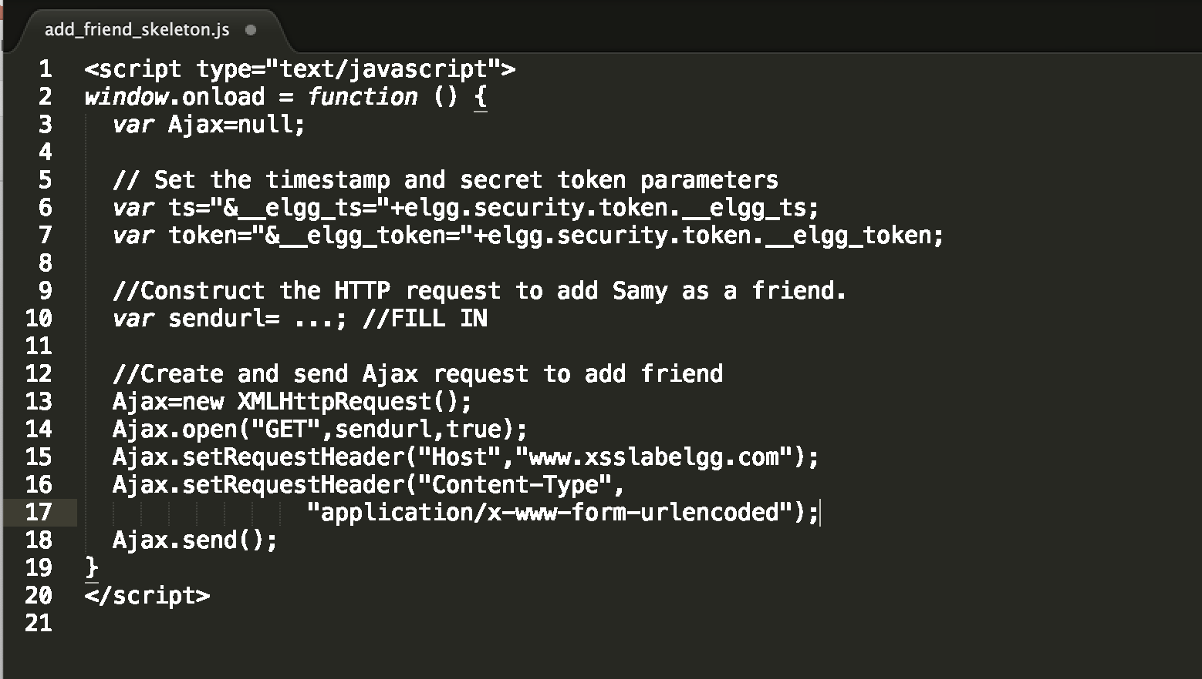
Skeleton Code:
Check off
1. Finish the skeleton code to add Samy as a friend through XSS
2. Snapshots showing the effectiveness of the XSS and briefly explain what you did.
3. Answer the questions after Task 4

Slide 4
Task 5: Edit Victim’s Profile
Goal: Modify Alice’s profile using XSS attack
Step 1: Find the normal process of editing a Alice’s profile?
Similar to the CSRF attack
Look into the HTTP Header
Step 2: Inject JS code in the attacker’s page that craft a HTTP POST request
Using both JS and Ajax

Slide 5
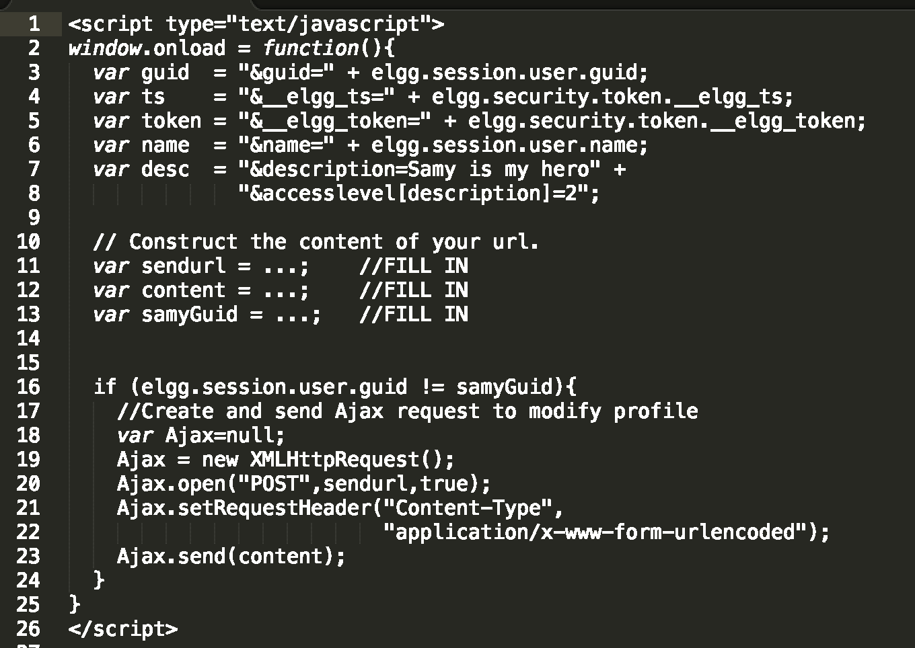
Skeleton Code:
Checkoff
1. Finish the skeleton code to modify the victim’s profile.
2. Snapshots showing the effectiveness of the XSS and briefly explain what you did.
3. Answer the question after Task 5

Slide 6
Task 6 Self-propagating
Link approach
Worm included in the ‘src’ of a <script> tags
Think about how to copy the url of the script to the victim’s profile
For the ‘xss_worm.js’ do take care whether the code should or should not be wrapped by the <script> tags
Follow the instructions to create ‘example.com’, note that ‘/var/www/Example’ won’t be generated automatically, you need to create it.
DOM approach
Using the DOM API to reference the jsCode.
Construct the headerTag and tailTag properly
You may reuse the code in task 5 to modify a victim’s profile.

Slide 7
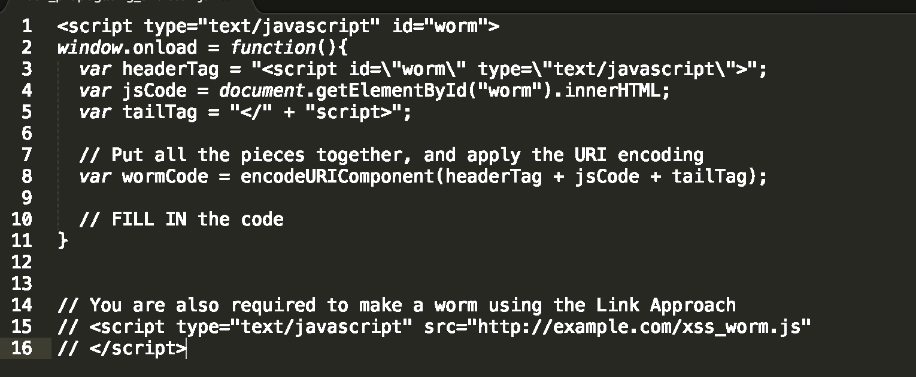
Skeleton Code:
Check off
1. Finish the skeleton code to finish a XSS worm that both modify the victim’s profile (no need to add friend) and can self propogate, using BOTH Link approach and DOM approach
2. Snapshots showing the effectiveness of the XSS worm and briefly explain what you did.

Slide 8
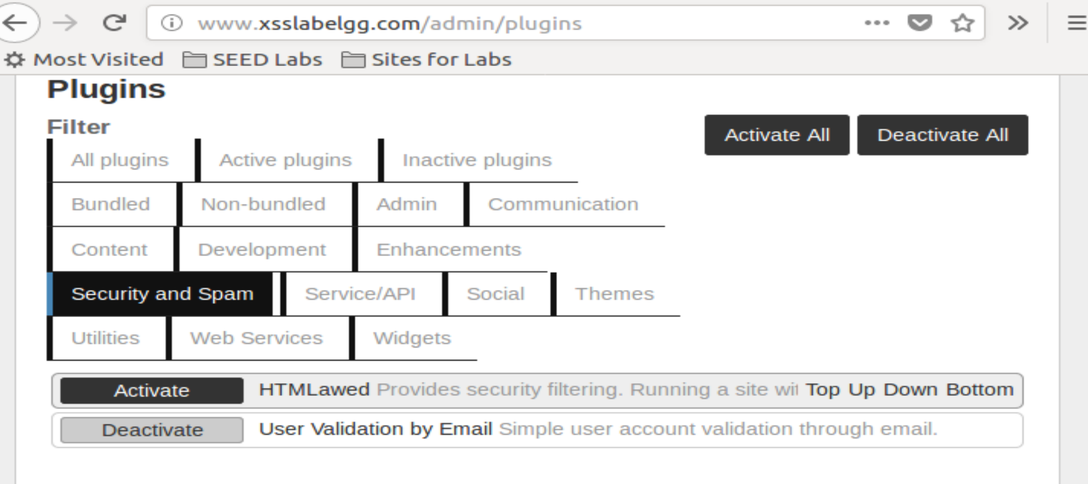
Task 7
Enable the HTMLawed
Enable htmlspecialchars()

Slide 9
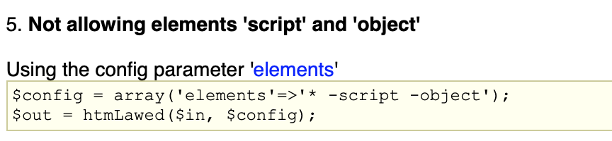
What is HTMLawed?
It allows the user to filter html tags
Allow all tags except uncommon ones
Filter out ’<script>’ tags
More examples about HTMLawed settings: http://www.bioinformatics.org/phplabware/internal_utilities/htmLawed/example_settings.htm

Slide 10
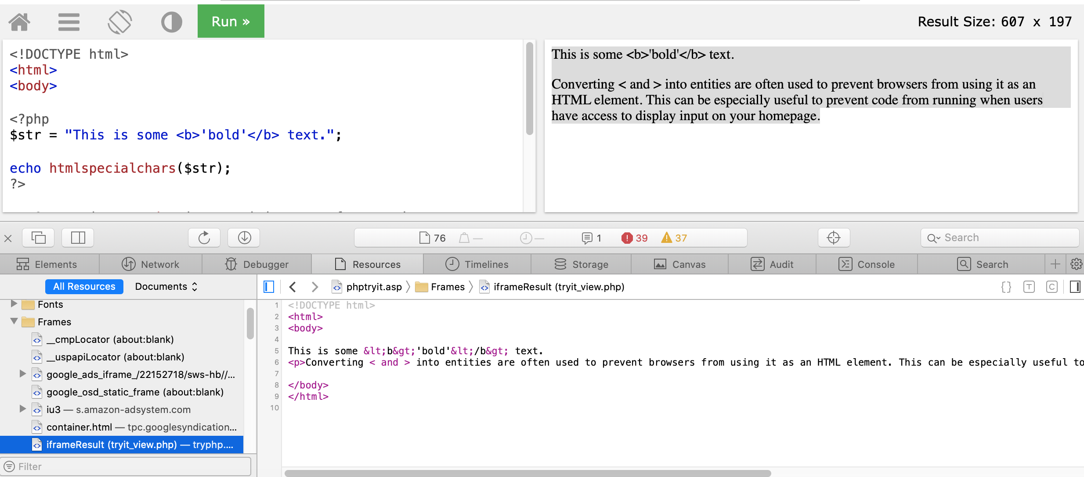
What is htmlspecialchars()
This function encodes special characters in HTML file
Example: https://www.w3schools.com/php/func_string_htmlspecialchars.asp
To see the results you need to view source page: https://www.computerhope.com/issues/ch000746.htm
How to interpret this one?
﻿echo htmlspecialchars($vars['value'], ENT_QUOTES, 'UTF-8', false);

Slide 11
Checkoff
Enable the counter measures and answer the questions after Task 7

